Slide 1

Basic Details of the Team and Problem Statement
Ministry/Organization Name/Student Innovation: Ministry of Commerce and Industries
PS Code: SIH1385
Problem Statement Title: Developing a software that can translate resource material and other texts from English to other Indian regional languages.
Team Name: Byte Busters.
Team Leader Name: SUYASH GANESH PATIL
Institute Code (AISHE): C-1371
Institute Name: New Horizon College Of Engineering
Theme Name: Smart Education

Slide 2
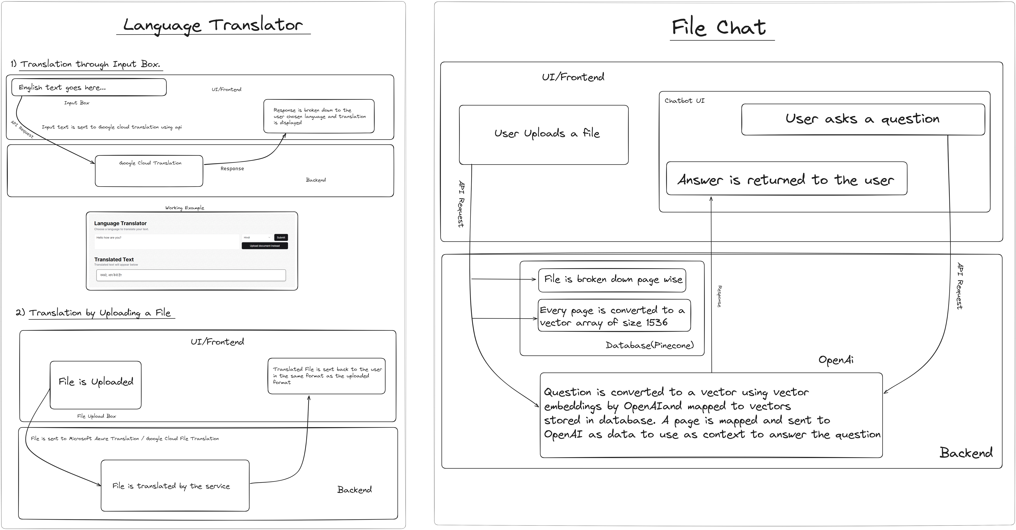
Architecture/System Design

Slide 3
Idea/Approach Details
Describe your idea/Solution/Prototype here:
IPRTranslate: Revolutionizing IPR in India IPRTranslate is a game-changing software solution that simplifies intellectual property rights (IPR) understanding in India. Translation: Seamlessly translates IPR content into regional languages, powered by the Google Cloud Translation API.
Collaboration: Enables real-time collaboration within PDFs, enhancing teamwork and document understanding.
AI Insights: Utilizes vector embeddings and the Google Cloud Translation API for content summarization and intelligent searches.
Empowers students, innovators, legal professionals, industries, law enforcement, customs, and the general public. Accelerates IPR awareness, commercialization, and enforcement, fostering innovation and protection. Promises to transform India's IPR landscape by breaking language barriers and promoting collaboration.
Describe your Technology stack here:
NextJS (React)
Google Cloud Translation API
Supabase and Pinecone (Databases)
OpenAI API

Slide 4
Idea/Approach Details
Describe your Use Cases here
Describe your Dependencies / Show stopper here
Education and Training: Simplifying IPR education for students and learners by providing content in regional languages.
Innovation and Creativity: Empowering innovators and creators to understand and protect their intellectual property assets.
Legal Practice: Assisting legal professionals in interpreting complex legal texts and regulations.I
ndustry Advancement: Informing industries for better decision-making on intellectual property and innovation.
Law Enforcement: Supporting police and agencies in enforcing IPR-related regulations and combating counterfeits.
Judiciary Support: Aiding judges and the judiciary in making informed decisions on IPR cases.
Customs and Trade: Helping customs officials enforce import and export regulations related to IPR.
General Public Awareness: Fostering a culture of innovation and respecting intellectual property rights among the general public.Real-Time Collaboration: Enhancing teamwork and document understanding through real-time collaboration within PDFs.
Google Cloud Translation : Uses Google’s neural machine translation technology for domain- and context-specific terms or phrases, and formatted document translation generating output that captures the true meaning of the text and not just the literal meaning .
Conversation with PDF’s : Allows user to talk to a pdf using Vector Embeddings and OpenAI API. It leverage the power of AI to help understand a document better.
Accuracy of Translations: Inaccurate translations can lead to misunderstandings and misinterpretations of IPR materials. Achieving a high level of accuracy in translation is critical to the solution's success.

Slide 5
Team Member Details
Team Leader Name: SUYASH GANESH PATIL
Branch (Btech/Mtech/PhD etc): Btech Stream (ECE, CSE etc): CSE Year (I,II,III,IV): II
Team Member 1 Name: RAJATH U SHETTY
Branch (Btech/Mtech/PhD etc): Btech Stream (ECE, CSE etc): CSE Year (I,II,III,IV): II
Team Member 2 Name: SARIKA SUMAN
Branch (Btech/Mtech/PhD etc): Btech Stream (ECE, CSE etc): CSE Year (I,II,III,IV): II
Team Member 3 Name: VAIBHAV SORCAR
Branch (Btech/Mtech/PhD etc): Btech Stream (ECE, CSE etc): CSE Year (I,II,III,IV): II
Team Member 4 Name: KIRAN RAJ B
Branch (Btech/Mtech/PhD etc): Btech Stream (ECE, CSE etc): CSE Year (I,II,III,IV): II
Team Member 5 Name: SHAILESH J KUNDER
Branch (Btech/Mtech/PhD etc): Btech Stream (ECE, CSE etc): ECE Year (I,II,III,IV): II
Team Mentor 1 Name: Dr Prianka RR
Category (Academic/Industry): Academic Expertise (AI/ML/Blockchain etc): AIML Domain Experience (in years): 13 years
Team Mentor 2 Name: Ms Shruthi Somashekhar
Category (Academic/Industry): Academic Expertise (AI/ML/Blockchain etc): AIML Domain Experience (in years): 3 years

